Slide 1
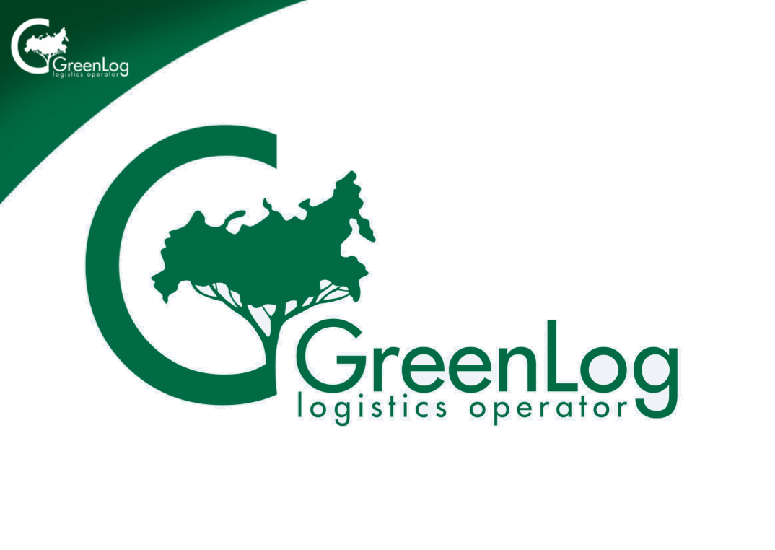

Slide 2
Your Eco-Friendly Operator “Green Logistics”
WE SPECIALIZE IN:
Fast and qualified Transportation
of Assembled Goods;
Individual Guiding of Every Client by the Representative of Our Company;
Transparent Tariffs, Quotes and Prices;
Online Consultations and Online Accounts on Transportation of Goods in “Personal Account”;
Electronic System of Documentation in ‘Personal Account”;
Real-Time Tracking Your Goods` Transportation Rout on the Company Site.
WE PROVIDE SERVICE OF:
Standard Packages / STANDARD TARIFF-priced transportations/;
AND
Individual Packages , created and worked out by the company to fulfill any Customer` Expectations;
WE TRANSPORT GOODS BY RAILROADS AND HIGHWAYS!

Slide 3
The competitive advantages of our company are the following:
Highest Service Quality after your first call;
Individual recommendations and logistic decision for every client;
Non-fixed, BUT DISCUSSABLE price which is the bonus in comparison with other FEDERAL companies;
A warm pack house, especially important in cold Russian winters;
Fast delivery to any point of destination in the country.
Our Company Takes Part in Charity Program: a special sum of money is deducted from every kilogram of transported goods in order we could buy and grow trees in the country regions.

Slide 4
What else are we?
A Logistic Company of High Professionals in Transportations of Goods; Experienced, Honest and Reliable.
Our Mission is to use modern technologies, first-class equipment and latest eco-friendly transportation vehicles as well as fastest and most reliable means of delivery ,serving our clients and aiming to protect natural resources.
“Green Logistics” is the first socially-oriented transportation company in modern Russia which
gives a part of its profit to support a green belt.
We invite everybody to cooperation!
Take part in the project of restoring parks and forests
of the country where you live or work!

Slide 5
OUR CONTACTS
in Moscow:

